Slide 1

Metal 3D Printer 2nd Prototype Demo
Nathan Krikawa, Nolan Hann

Slide 2

Q & A
What question are you trying to answer with the prototype?
How do the stresses of our optimized models compare to our original models? Do we need to add or subtract mass to avoid deformation?
Methods/manufacturing process used?
3D printing plastic, FDM.
SolidWorks, Blender, ANSYS SpaceClaim
What was the answer?
Hanger: Add mass
Base Plate: No changes
Crank arm: Add mass
How did the answer inform design/how do you plan to iterate based on this new info?
The answer informed us of which models we need to re-optimize at a different percentage mass reduction to improve their strength. It also informed us that adjustments to the original forces to align with a factor of safety could be made to achieve more accurate and comparable results.
What team member was responsible for what?
Nathan: Skateboard Truck
Nolan: Crank Arm
Notes:
Overview:
Installing and Troubleshooting a M100LabR Concept Laser PBF Printer
Printing and evaluating parts and specimens (ie Stress-Strain, Thermal Management)
Creation of a user manual and short curriculum for ME286L
Included is the printer itself, powder mixer, powder trolley, and various powdered alloys for use with the printer
Location of set-up: CEIAS IDEA Lab, Room 116A

Slide 3
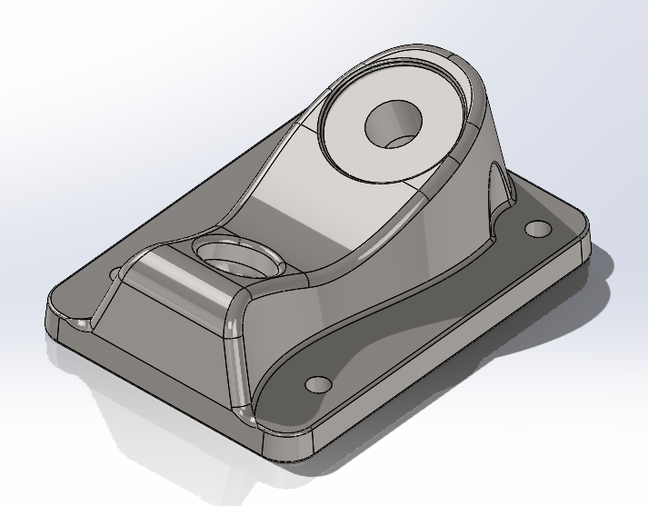
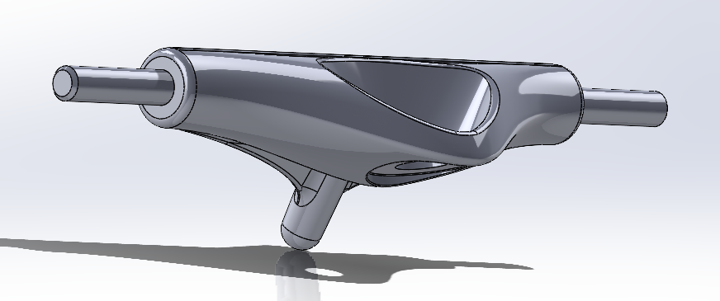
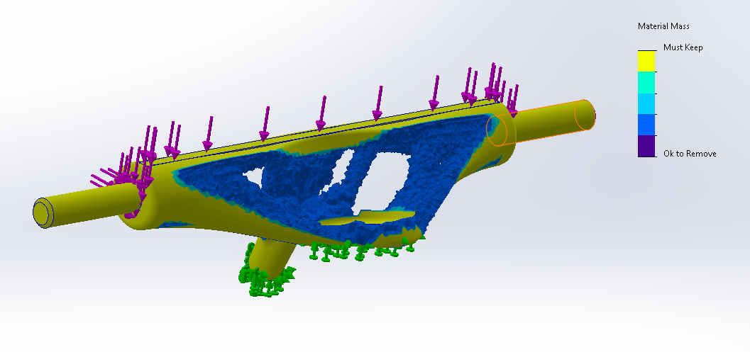
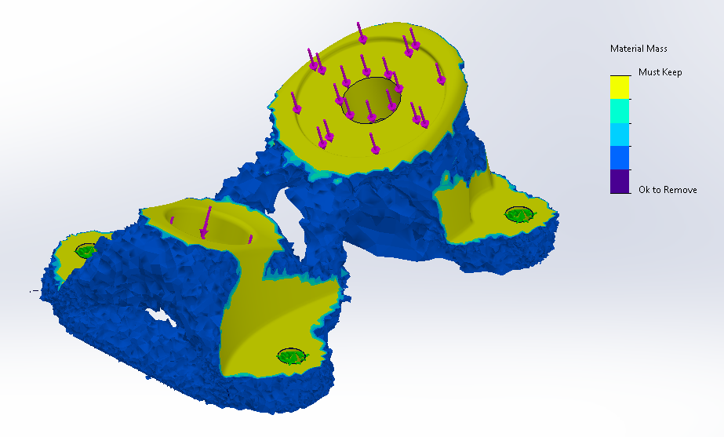
Optimized Truck
Figure 1: Original Hanger
Figure 2: Original Base Plate
Figure 3: Hanger Optimization Results (60%)
Figure 4: Base Plate Optimization Results (60%)
Notes:
Overview:
Installing and Troubleshooting a M100LabR Concept Laser PBF Printer
Printing and evaluating parts and specimens (ie Stress-Strain, Thermal Management)
Creation of a user manual and short curriculum for ME286L
Included is the printer itself, powder mixer, powder trolley, and various powdered alloys for use with the printer
Location of set-up: CEIAS IDEA Lab, Room 116A

Slide 4
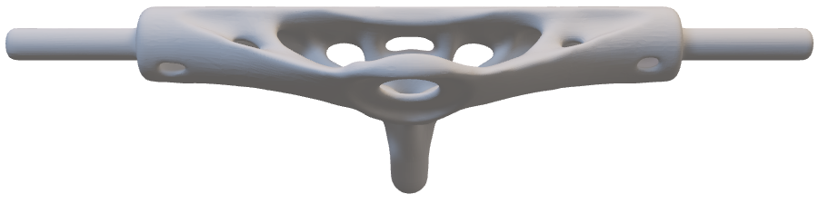
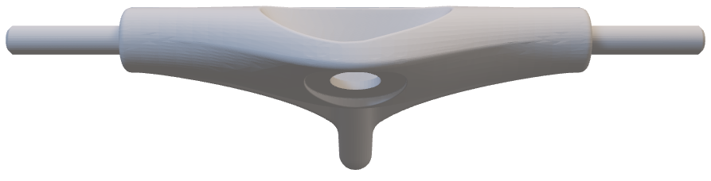
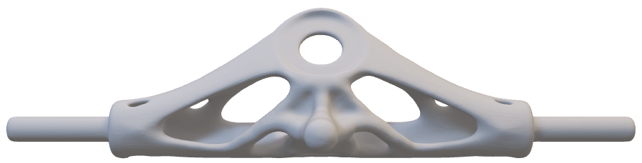
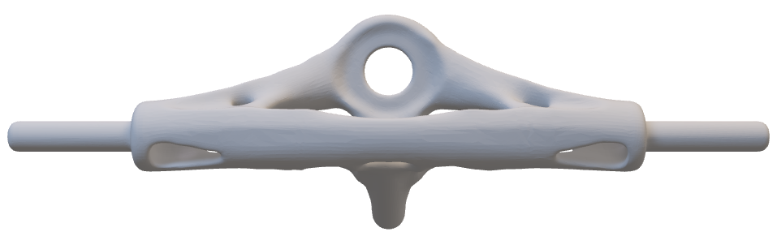
Optimized Hanger
Notes:
Overview:
Installing and Troubleshooting a M100LabR Concept Laser PBF Printer
Printing and evaluating parts and specimens (ie Stress-Strain, Thermal Management)
Creation of a user manual and short curriculum for ME286L
Included is the printer itself, powder mixer, powder trolley, and various powdered alloys for use with the printer
Location of set-up: CEIAS IDEA Lab, Room 116A

Slide 5
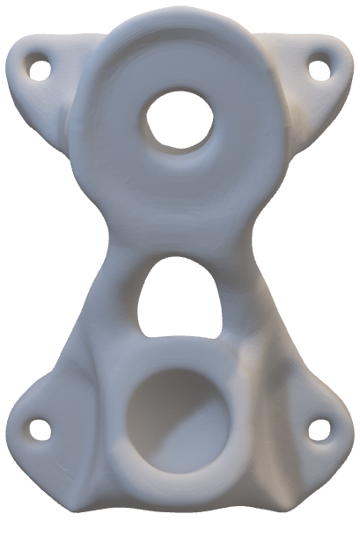
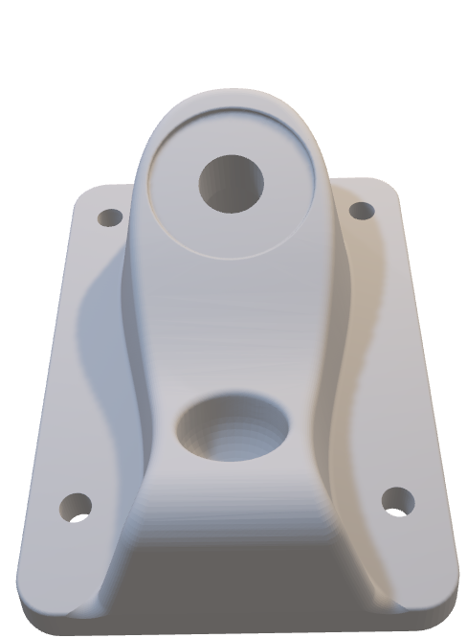
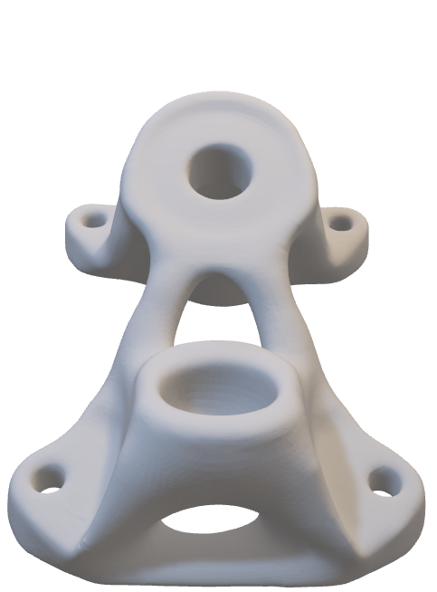
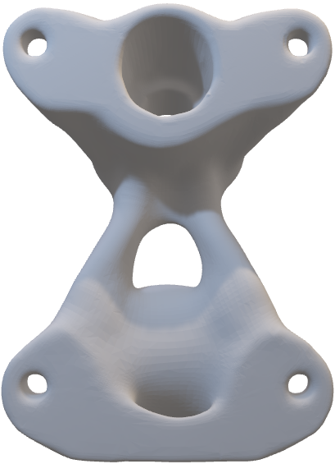
Optimized Base Plate
Notes:
Overview:
Installing and Troubleshooting a M100LabR Concept Laser PBF Printer
Printing and evaluating parts and specimens (ie Stress-Strain, Thermal Management)
Creation of a user manual and short curriculum for ME286L
Included is the printer itself, powder mixer, powder trolley, and various powdered alloys for use with the printer
Location of set-up: CEIAS IDEA Lab, Room 116A

Slide 6
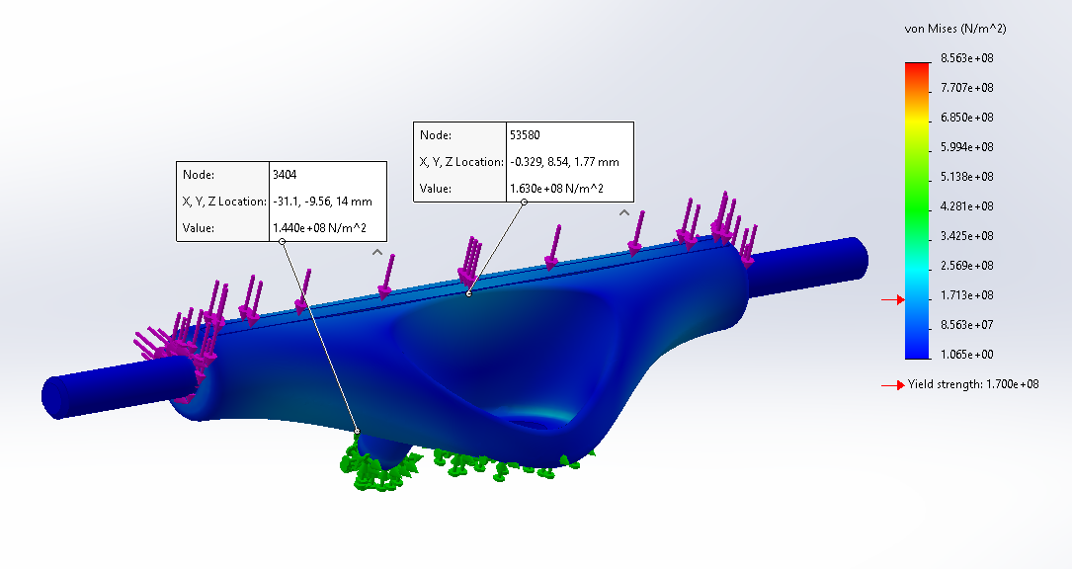
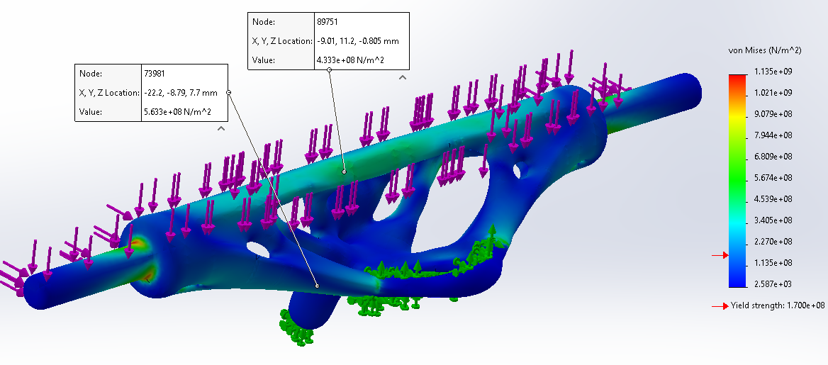
Skateboard Truck
Figure 5: Original Hanger FEA
Figure 6: Optimized Hanger FEA (60%)
Notes:
Overview:
Installing and Troubleshooting a M100LabR Concept Laser PBF Printer
Printing and evaluating parts and specimens (ie Stress-Strain, Thermal Management)
Creation of a user manual and short curriculum for ME286L
Included is the printer itself, powder mixer, powder trolley, and various powdered alloys for use with the printer
Location of set-up: CEIAS IDEA Lab, Room 116A

Slide 7
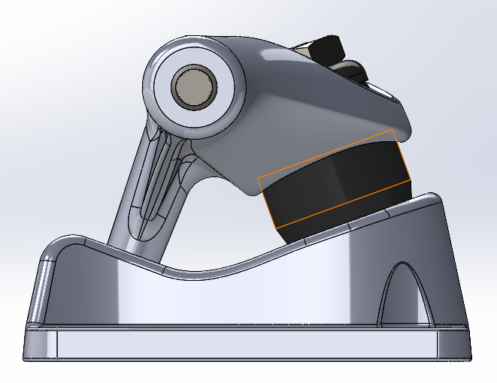
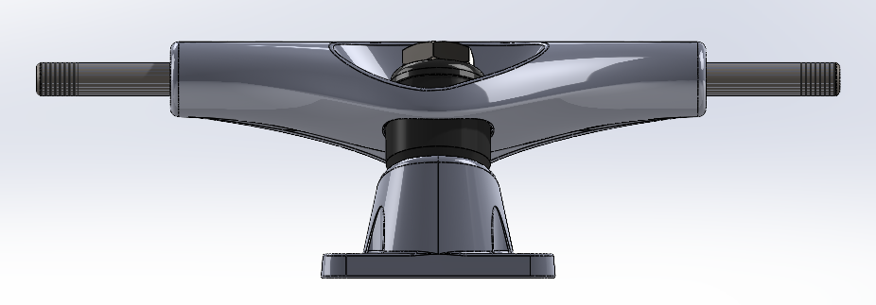
Skateboard Truck
Load Situations:
All the following load conditions are applied at the same time for the FEA and topology optimization.
Grinding on truck:
Distributed load along the top of the truck.
Calculated as an impact force of a 250lb person and 5.5lb skateboard falling 3ft onto one truck with an impact time of 0.1 seconds
4927N distributed along surface.
Meant to account for the initial impact of the truck landing on a rail or ledge, not accounting for horizontal momentum.
Landing on truck:
Vertical point loads at both ends of the truck.
Calculated as an impact force of a 250lb person and 5.5lb skateboard falling 5ft onto one truck with an impact time of 0.1 seconds
6345N split between each end.
Meant to account for the impact of a person landing on one truck, not accounting for horizontal momentum
Running into an obstacle:
Horizontal point loads at both ends of the truck.
Calculated as an impact force of a 250lb person and 5.5lb skateboard hitting an obstacle at 10mph with an impact time of 0.1 seconds
5186N applied to each end separately.
Meant to account for the impact of a person running into a rock or curb with one wheel.
Notes:
Overview:
Installing and Troubleshooting a M100LabR Concept Laser PBF Printer
Printing and evaluating parts and specimens (ie Stress-Strain, Thermal Management)
Creation of a user manual and short curriculum for ME286L
Included is the printer itself, powder mixer, powder trolley, and various powdered alloys for use with the printer
Location of set-up: CEIAS IDEA Lab, Room 116A

Slide 8
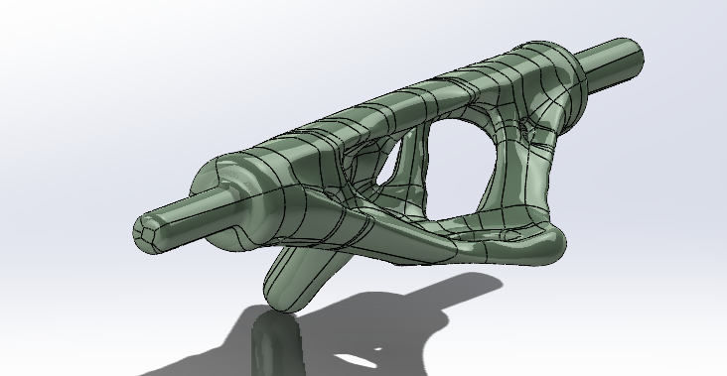
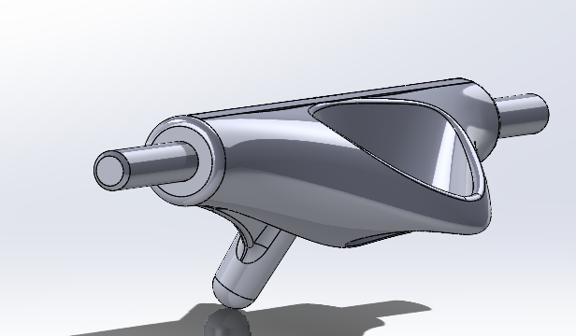


Skateboard Truck
Load Images Explained:
The differences in the distribution of the loads in the FEA diagrams is due to a difference in the available faces on which to apply the loads.
The original model has convenient places to apply loads (highlighted), whereas the optimized model does not.
The optimized model was created as a STEP file from an STL, giving no control over the faces generated, therefore when applying loads, I applied them to the closest faces possible with the same direction and magnitude.
This is why, for example, figure 6 has stresses where the hanger meets the axle and figure 5 does not. The end loads are originally applied to the face on the end of the hanger avoiding the axle (which we won't be changing due to assembly constraints), whereas in the optimized model that face is not available, and the closest available faces include the axle.
The results will be slightly different, but still form a decent picture of how the optimized model will handle the proposed load situations.
Notes:
Overview:
Installing and Troubleshooting a M100LabR Concept Laser PBF Printer
Printing and evaluating parts and specimens (ie Stress-Strain, Thermal Management)
Creation of a user manual and short curriculum for ME286L
Included is the printer itself, powder mixer, powder trolley, and various powdered alloys for use with the printer
Location of set-up: CEIAS IDEA Lab, Room 116A

Slide 9
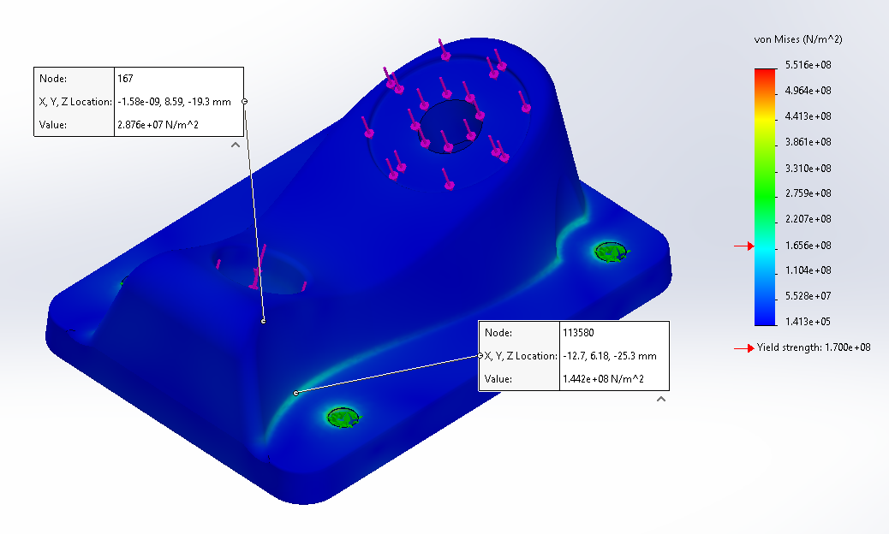
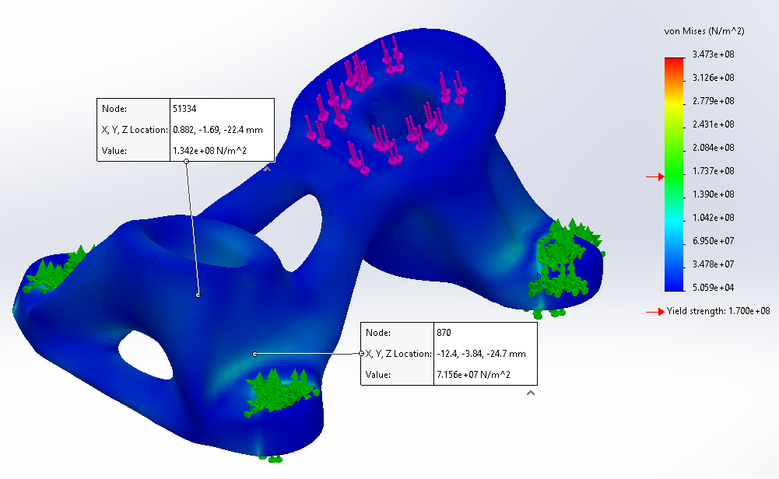
Skateboard Truck
Figure 7: Original Base Plate FEA
Figure 8: Optimized Base Plate FEA (60%)
Notes:
Overview:
Installing and Troubleshooting a M100LabR Concept Laser PBF Printer
Printing and evaluating parts and specimens (ie Stress-Strain, Thermal Management)
Creation of a user manual and short curriculum for ME286L
Included is the printer itself, powder mixer, powder trolley, and various powdered alloys for use with the printer
Location of set-up: CEIAS IDEA Lab, Room 116A

Slide 10
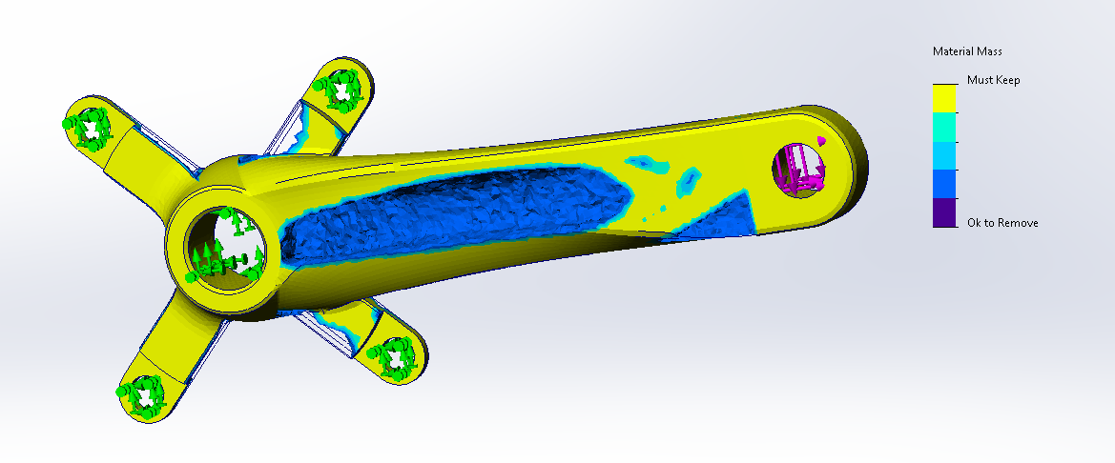
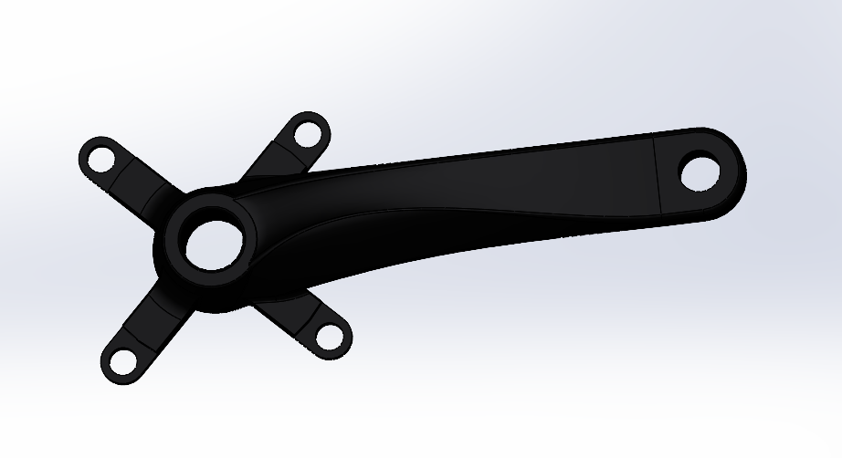
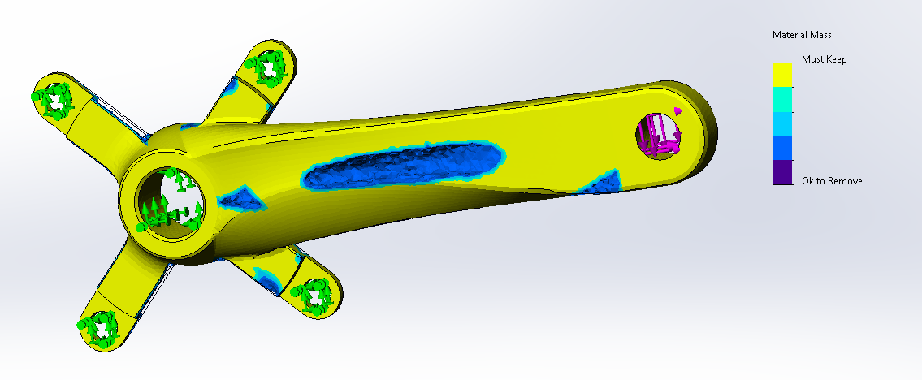
Bike Crank
Figure 10: Optimized Crank Arm (60%)
Figure 9: Original Crank Arm
Figure 11: Optimized Crank Arm (40%)
Notes:
Overview:
Installing and Troubleshooting a M100LabR Concept Laser PBF Printer
Printing and evaluating parts and specimens (ie Stress-Strain, Thermal Management)
Creation of a user manual and short curriculum for ME286L
Included is the printer itself, powder mixer, powder trolley, and various powdered alloys for use with the printer
Location of set-up: CEIAS IDEA Lab, Room 116A

Slide 11
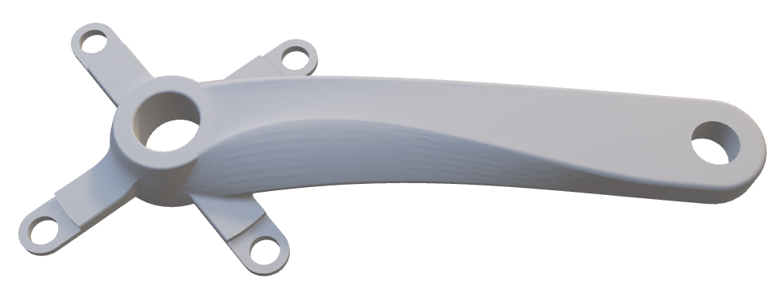
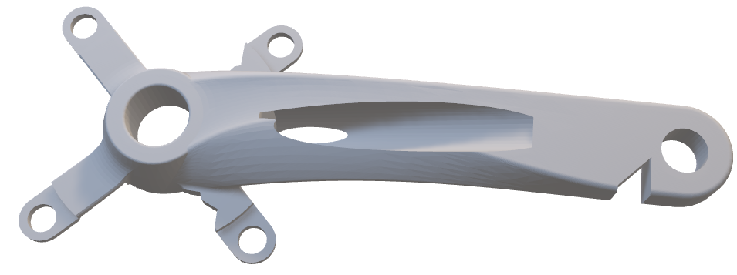
Bike Crank
Notes:
Overview:
Installing and Troubleshooting a M100LabR Concept Laser PBF Printer
Printing and evaluating parts and specimens (ie Stress-Strain, Thermal Management)
Creation of a user manual and short curriculum for ME286L
Included is the printer itself, powder mixer, powder trolley, and various powdered alloys for use with the printer
Location of set-up: CEIAS IDEA Lab, Room 116A

Slide 12
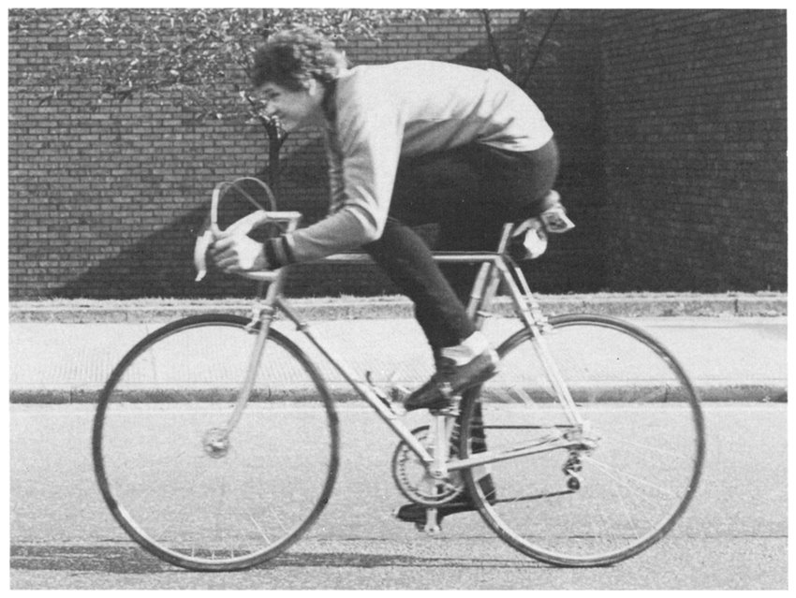
Loading Explained
Assuming the load is applied at a 45-degree angle, therefore a moment and an axial load was applied. The forces were applied to the inside of the pedal shaft, while fixtures were applied to the central shaft and the connections to the main gear.
P. D. Soden and B. A. Adeyefa, “Forces applied to a bicycle during normal cycling,” Journal of Biomechanics, vol. 12, no. 7, pp. 527–541, Jan. 1979, doi: https://doi.org/10.1016/0021-9290(79)90041-1.​
Notes:
Overview:
Installing and Troubleshooting a M100LabR Concept Laser PBF Printer
Printing and evaluating parts and specimens (ie Stress-Strain, Thermal Management)
Creation of a user manual and short curriculum for ME286L
Included is the printer itself, powder mixer, powder trolley, and various powdered alloys for use with the printer
Location of set-up: CEIAS IDEA Lab, Room 116A

Slide 13
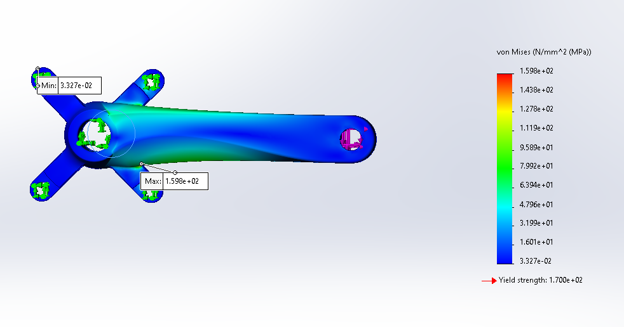
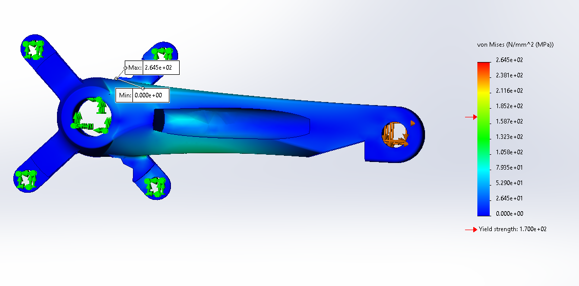
Bike Crank
Figure 12: Original Crank Arm FEA
Figure 13: Optimized Crank Arm FEA (60%)
Notes:
Overview:
Installing and Troubleshooting a M100LabR Concept Laser PBF Printer
Printing and evaluating parts and specimens (ie Stress-Strain, Thermal Management)
Creation of a user manual and short curriculum for ME286L
Included is the printer itself, powder mixer, powder trolley, and various powdered alloys for use with the printer
Location of set-up: CEIAS IDEA Lab, Room 116A

Slide 14

Thank You!
Any Questions?

